Slide 1


Generative AI
Prompts Engineering

Slide 2

Copyright Notice
These slides are distributed for educational purpose under the Creative Commons License.
https://creativecommons.org/licenses/by-sa/2.0/legalcode
Source of Slides:
DeepLearning.AI as the source of the slides.
Generative AI :)
Harvard Teaching and Learning Consortium

Slide 3
Prompts Engineering

Slide 4
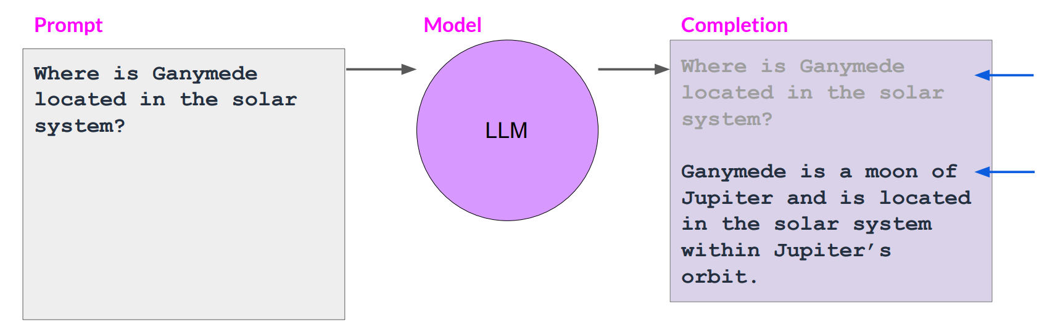
Prompts and completions
( prompt + compeletion) < context winodw

Slide 5
What is a prompt?

Slide 6
What is a prompt?
A prompt is a piece of text or an instruction given to an artificial intelligence model to generate a response.
It serves as the input that guides the model's output.
Examples:
"Write a poem about the moon" or "Translate this English sentence to French."
The model then generates a relevant response based on the given prompt.

Slide 7
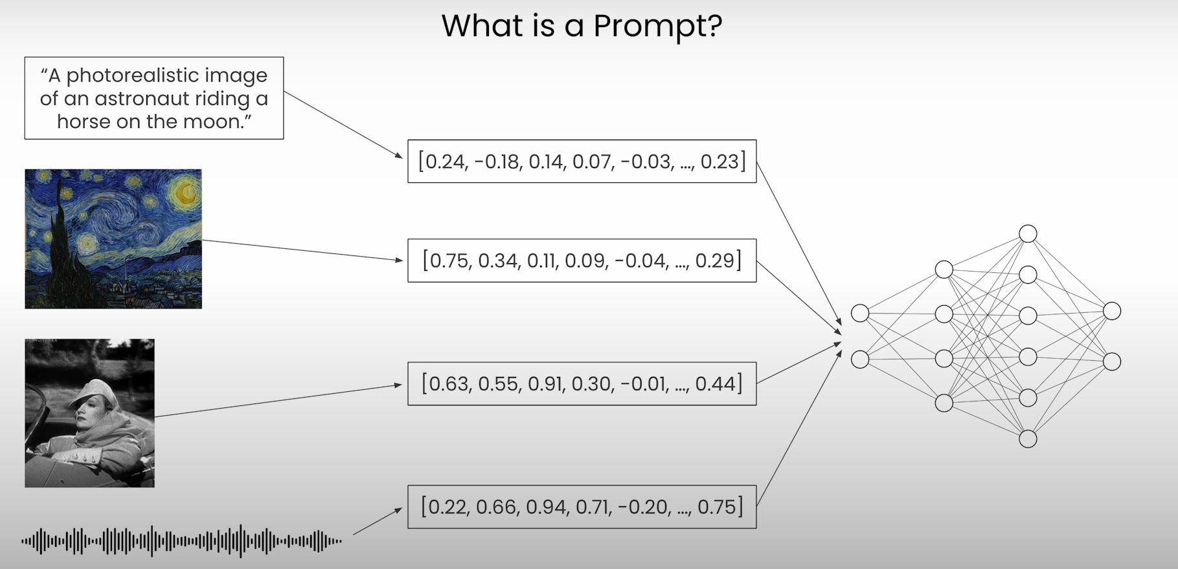
What is a prompt?

Slide 8
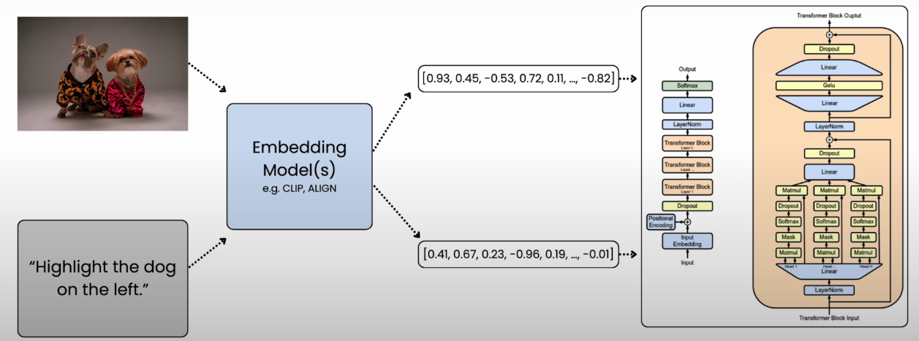
Embeddings

Slide 9

What is a visual prompt?

Slide 10
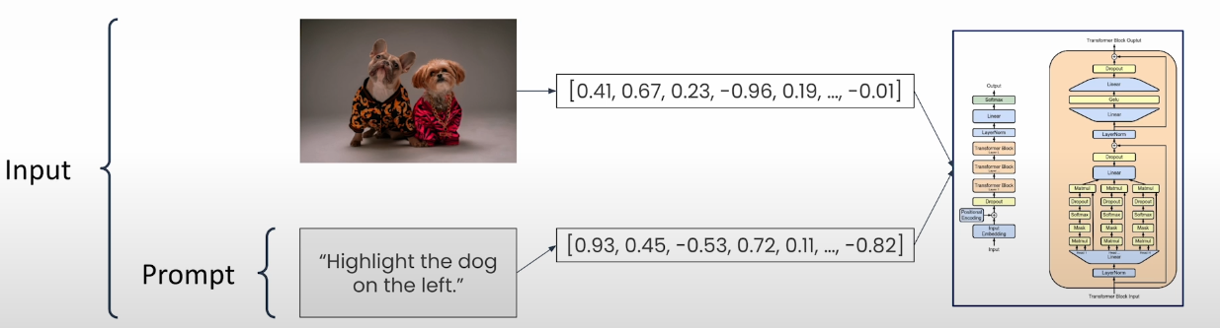
Prompt vs input

Slide 11
visual prompts

Slide 12

Generate images
Example generated images

Slide 13
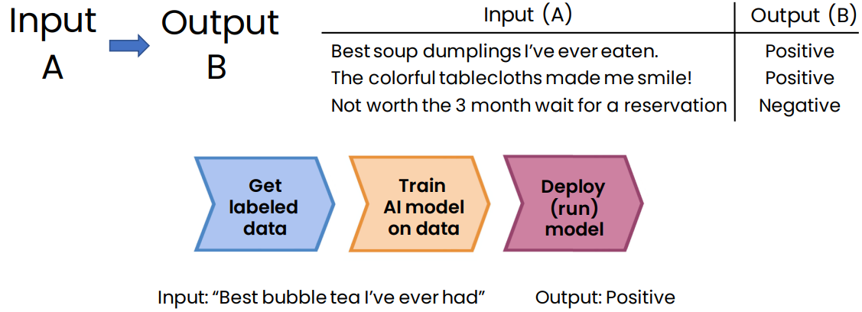
Supervised learning for restaurant reputation monitoring

Slide 14
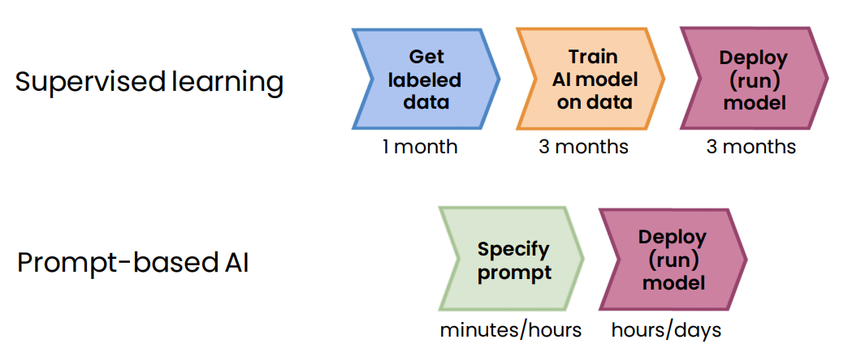
Workflow: supervised ML vs Generative AI

Slide 15
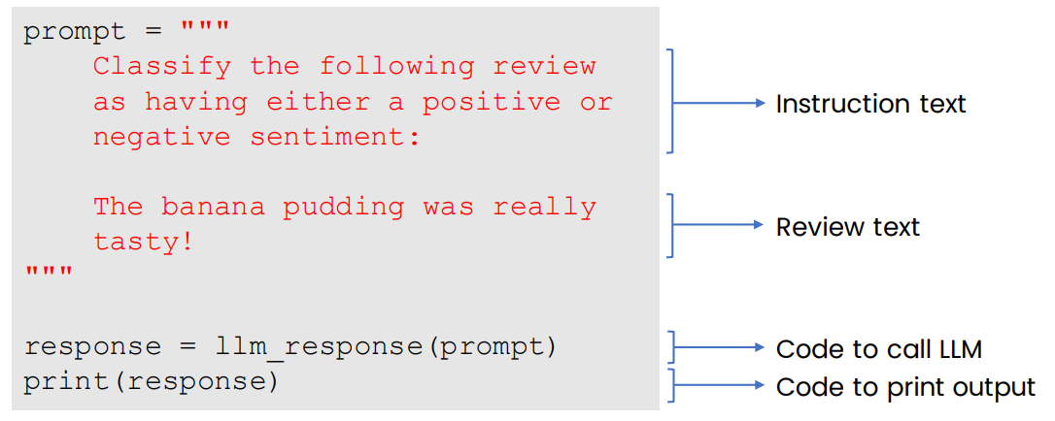
Prompt-based development

Slide 16
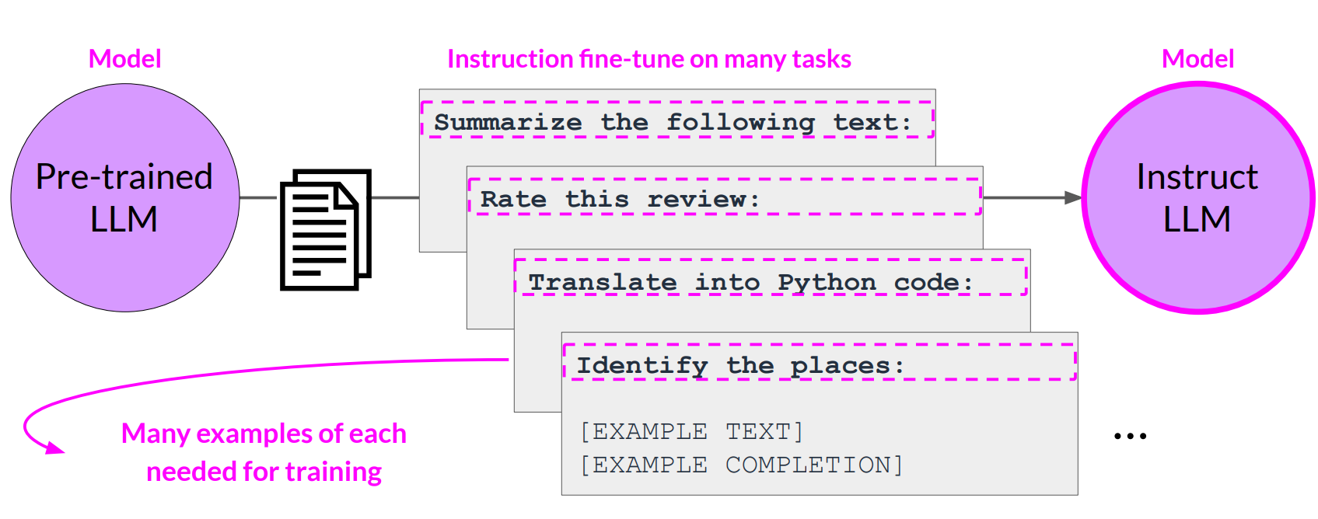
Thanks to Multi-task, instruction fine-tuning

Slide 17
Model Temperature

Slide 18
Temperature
Temperature is a crucial parameter that influences the randomness and creativity of generated text.
It ranges from 0 to 1, with higher values leading to more diverse and imaginative outputs, while lower values result in more predictable and conservative responses.
Essentially, adjusting the temperature allows you to control how "adventurous" or "safe" the LLM's generated content will be.
For instance, a higher temperature value (e.g., 1.0) encourages more exploration, while a lower value (closer to 0) produces more deterministic results.

Slide 19
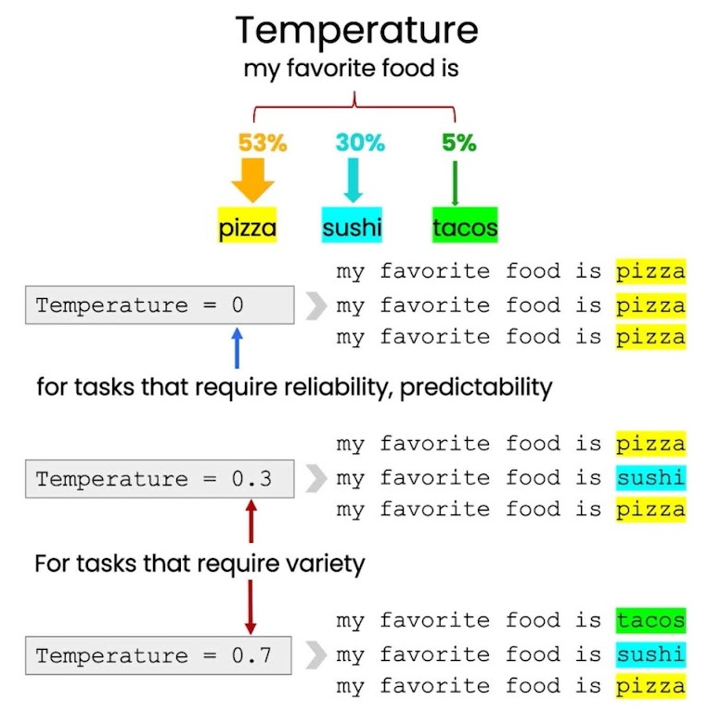

Slide 20
Prompt Engineering

Slide 21
What is Prompt engineering?
Prompt engineering is the process of refining prompts for generative AI services to create text or images.
It involves writing, refining, and optimizing inputs to encourage these AI systems to generate specific, high-quality outputs.
By crafting thoughtful prompts, prompt engineers help these models better comprehend and respond to a wide range of queries, from simple to highly technical ones.

Slide 22
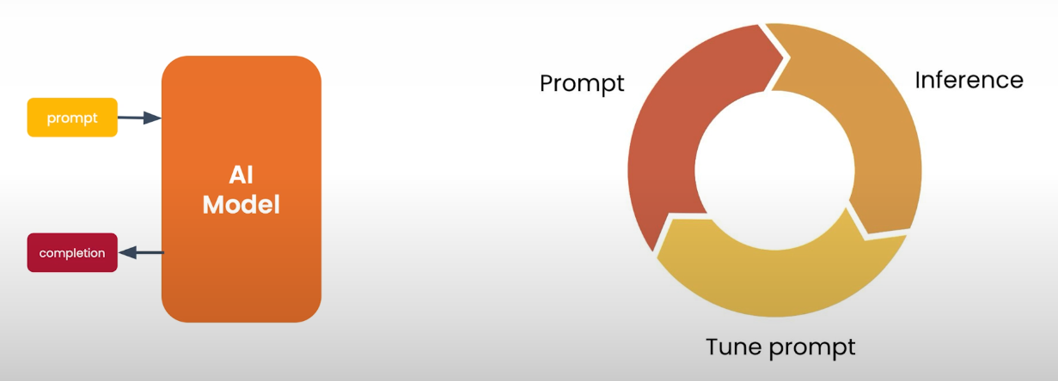
Prompt Engeering workflow

Slide 23
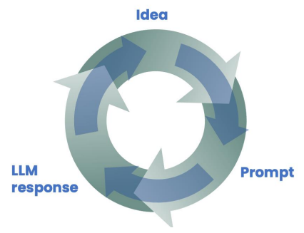
Tools to improve performance
Building Generative AI is a highly empirical (experimental) process – we repeatedly find and fix mistakes

Slide 24
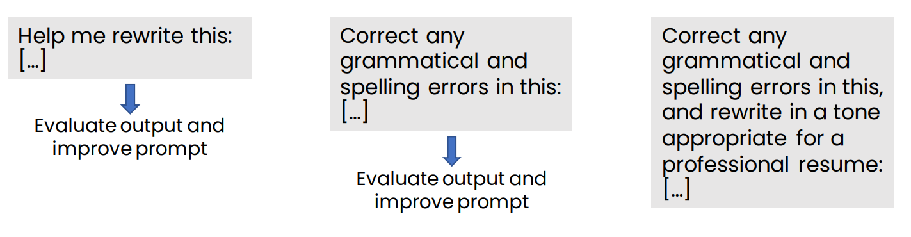
Experiment and iterate
No perfect prompt for every person or situation!
Instead, better to develop process for improving prompts through iteration

Slide 25
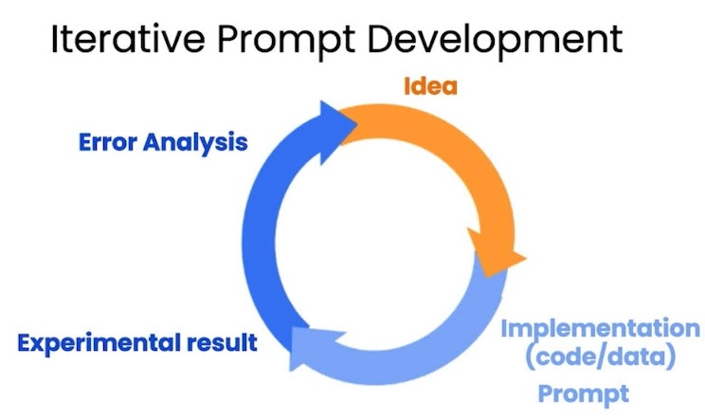
Iterative process
try something
analyze the output (good, bad)
clarify instructions, give more time to think
refine prompots with a batch of examples
tips:
do not overthink about the intial promp
just try something and improve
be clear and specifc
analyze why result is not good

Slide 26
Tips for prompting
Be detailed and specific
Guide the model to think through its answer
Experiment and iterate

Slide 27
Be detailed and specific
Give sufficient context for LLM to complete the task
Describe the desired task in detail
Help me write an email asking to be assigned to the legal documents project.
I’m applying for a job on the legal documents project, which will
check legal documents using LLMs. I have ample experience
prompting LLMs to generate accurate text in a professional tone.
Write a paragraph of text explaining why my background makes me a strong candidate to this project and advocate for my candidacy.

Slide 28
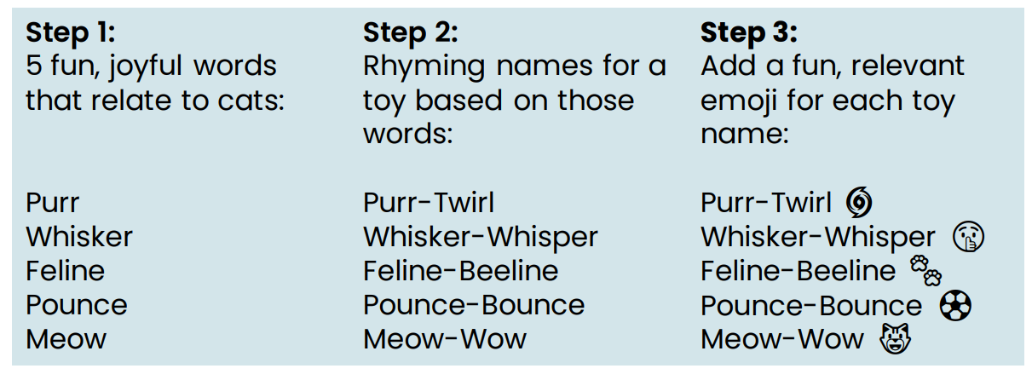
Guide the model to think through its answer
Brainstorm 5 names for a new cat toy.
Step 1: Come up with 5 fun, joyful words that relate to cats.
Step 2: For each word, come up with a rhyming name for a toy.
Step 3: For each toy name, add a fun, relevant emoji.

Slide 29
Principles of prompting
Principle 1
write clear and specifc instrcutions
clear ≠ short
Principle 2
give the model time to think

Slide 30
clear instructions
use delimters
triple quotes: “””
triple backticks: ```
triple dashes: ---
angle brackets: <>

Slide 31
Example prompt
You will be provided with text delimited by triple quotes. If it contains a sequence of instructions, re-write those instructions in the following format:
Step 1 - ...
Step 2 - …
…
Step N - …
If the text does not contain a sequence of instructions, then simply write "No steps provided."
"""
Making a cup of tea is easy! First, you need to get some water boiling. While that's happening, grab a cup and put a tea bag in it. Once the water is hot enough, just pour it over the tea bag. Let it sit for a bit so the tea can steep. After a few minutes, take out the tea bag. If you like, you can add some sugar or milk to taste. And that's it! You've got yourself a delicious cup of tea to enjoy.
"""

Slide 32
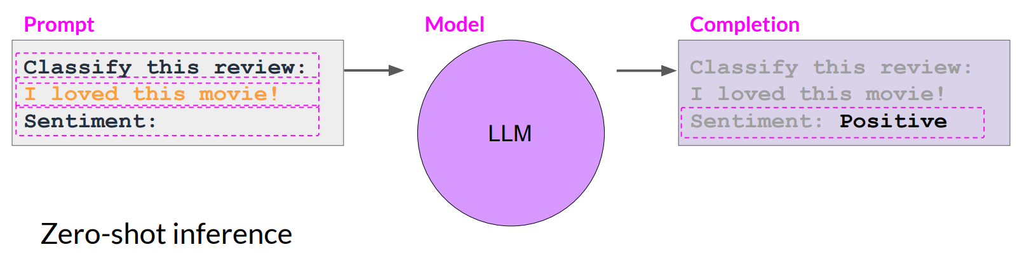
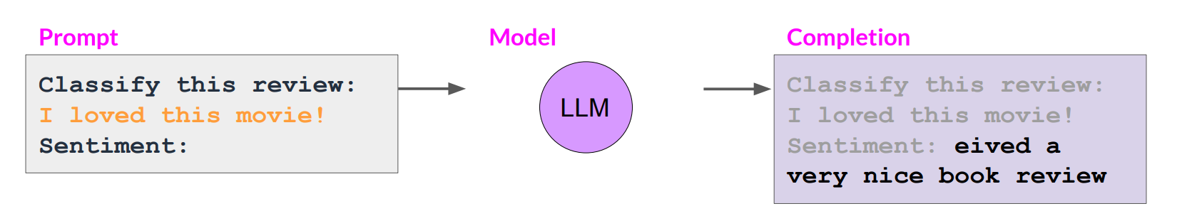
In-context learning (ICL) - zero shot inference
notice the impact of model size

Slide 33
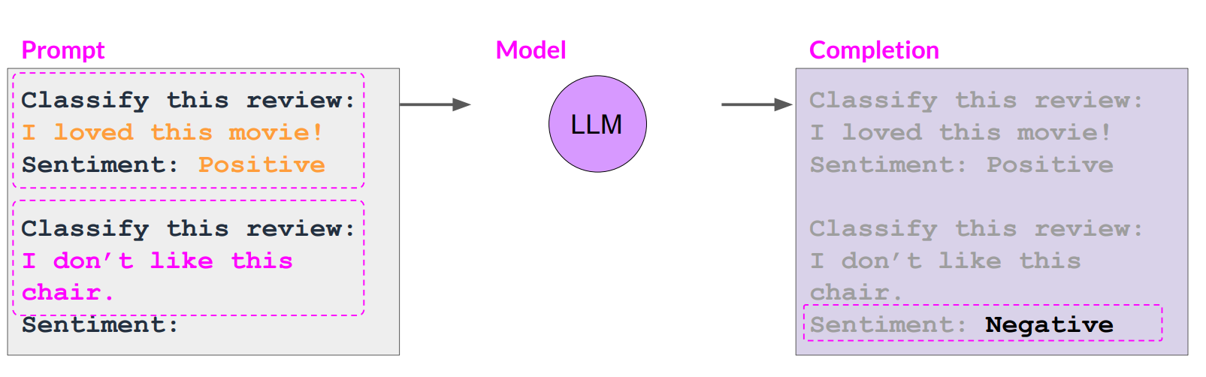
In-context learning (ICL) - one shots inference
notice the impact of model size: the output of the small model with one shot learning is good!

Slide 34
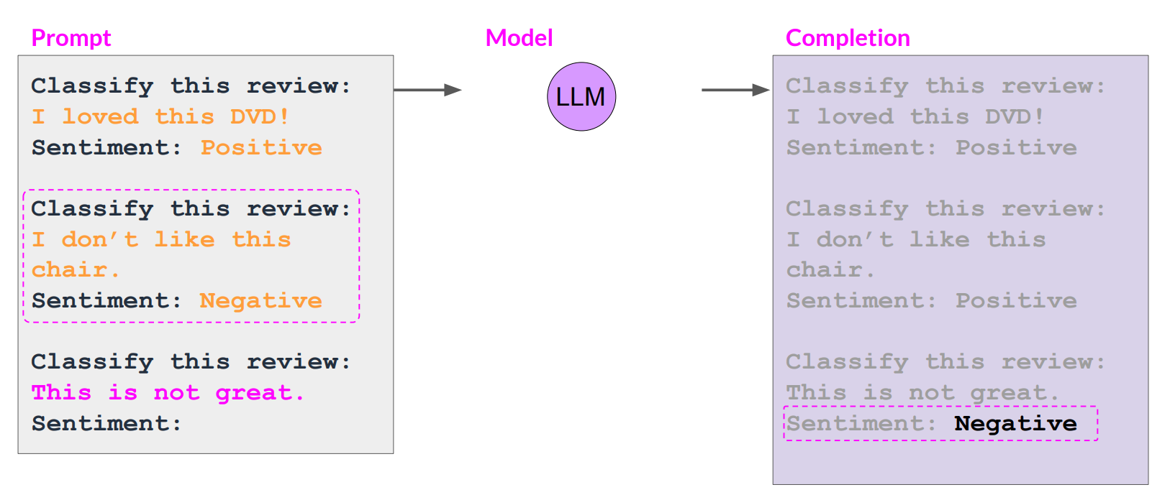
In-context learning (ICL) - few shots inference
notice the impact of model size: the output of the small model with few shots learning is good!

Slide 35
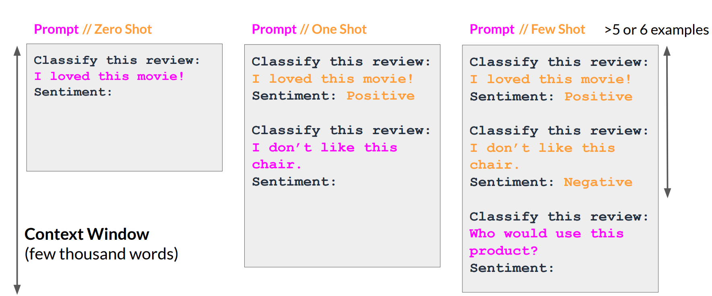
Summary of in-context learning (ICL)

Slide 36
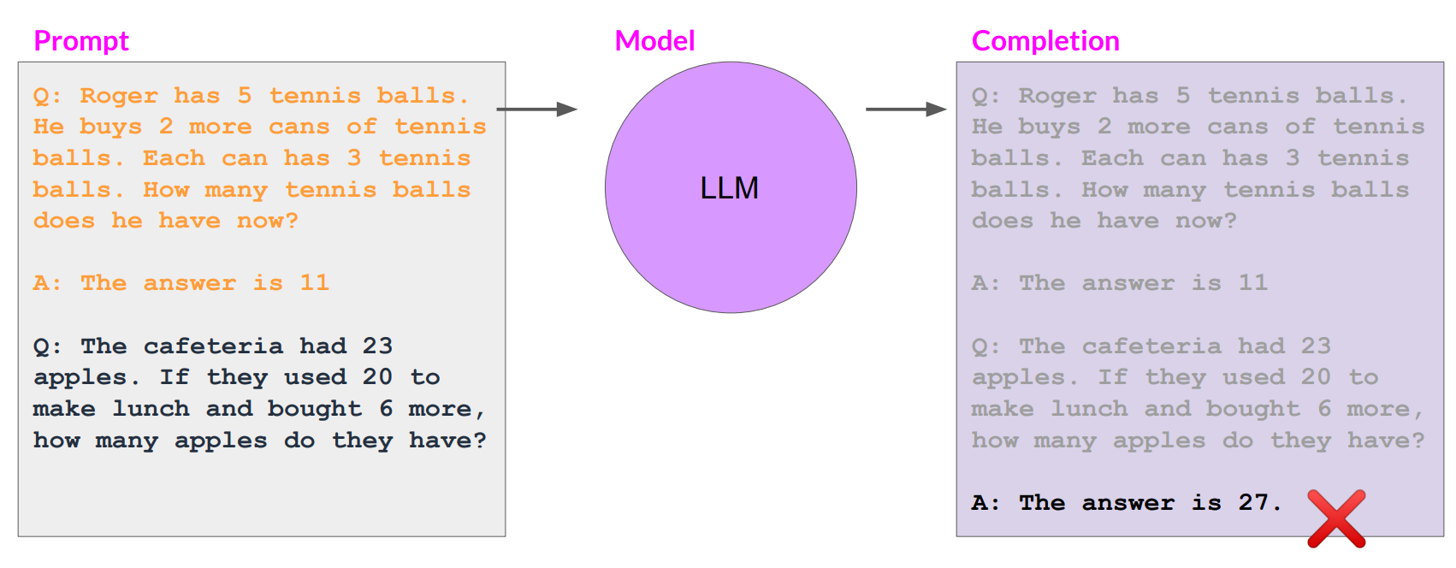
LLMs can struggle with complex reasoning problems

Slide 37
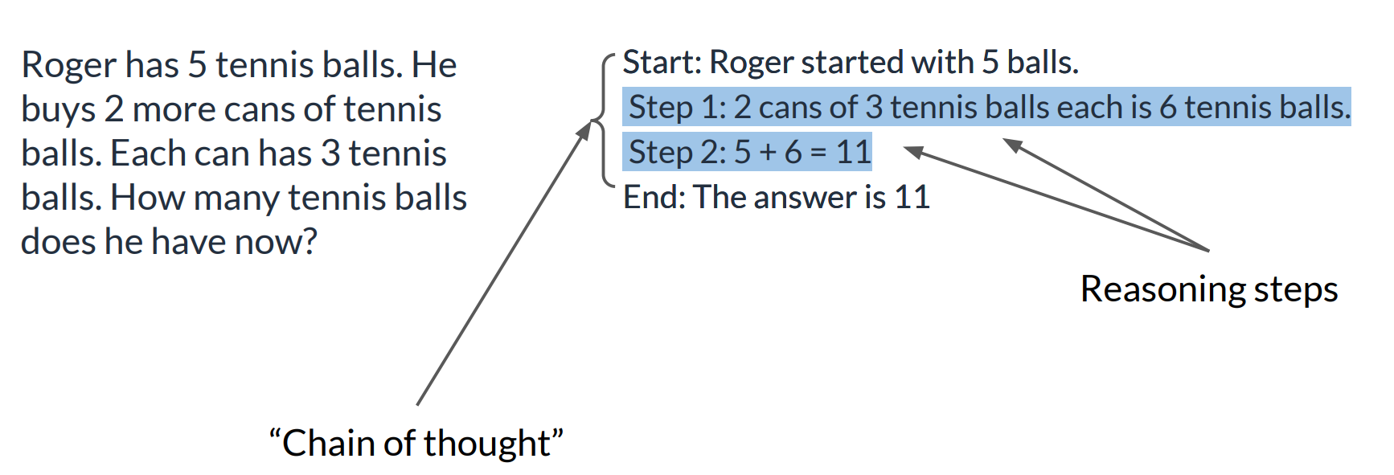
Humans take a step-by-step approach to solving complex problems

Slide 38
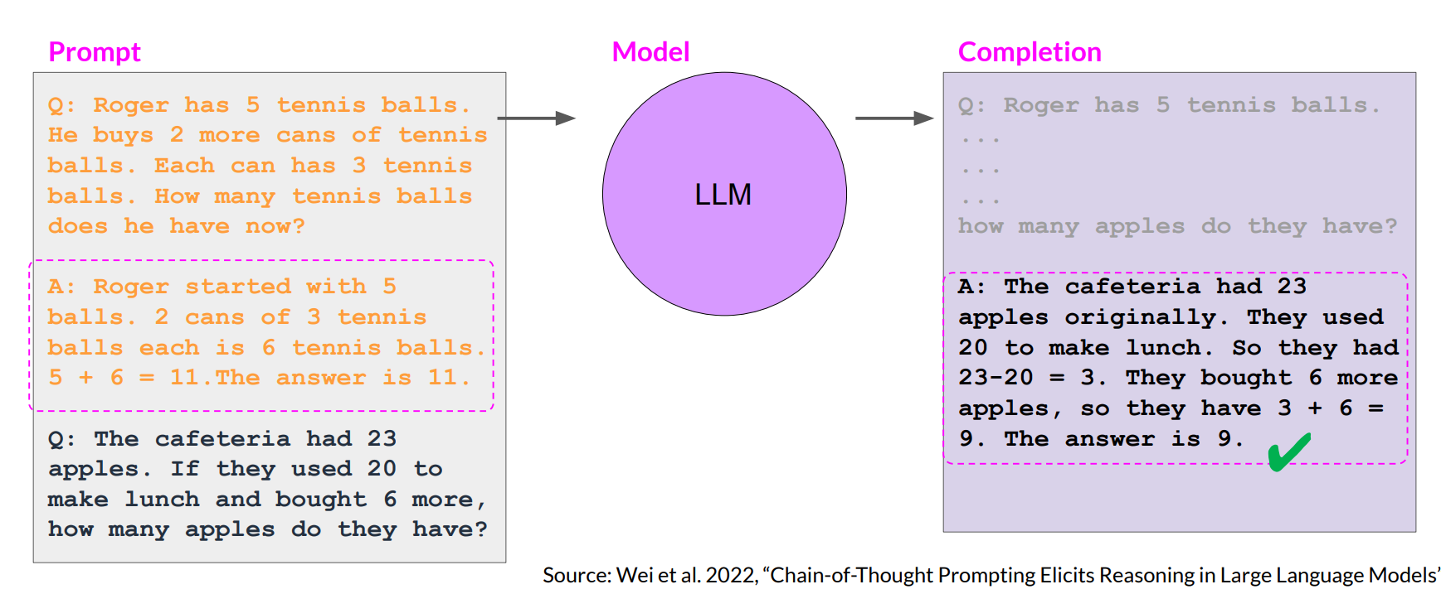
Chain-of-Thought Prompting can help LLMs reason

Slide 39
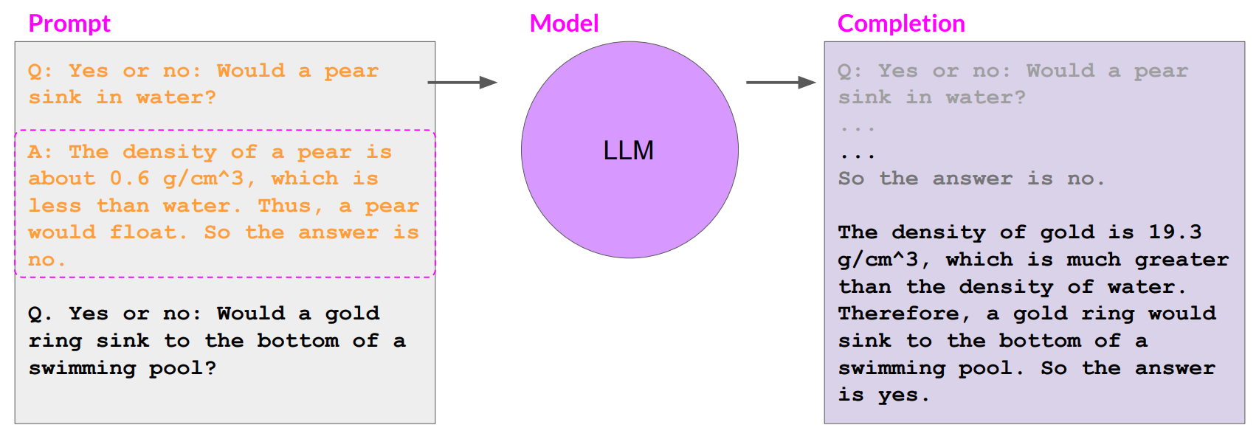
Chain-of-Thought Prompting can help LLMs reason

Slide 40
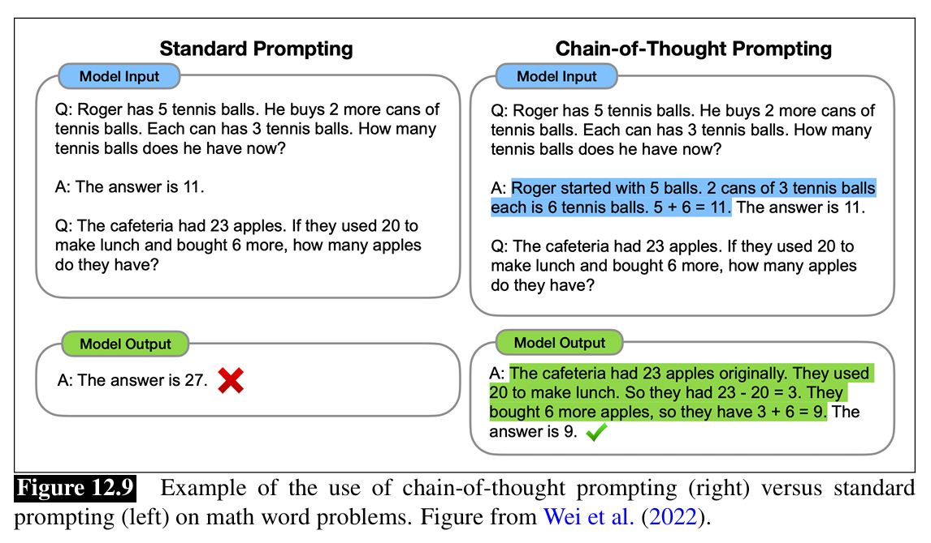
The goal of chain-of-thought prompting is to improve performance on difficult reasoning tasks that language models tend to fail on. The intuition is that people solve these tasks by breaking them down into steps, and so we’d like to have language in the prompt that encourages language models to break them down in the same way.

Slide 41
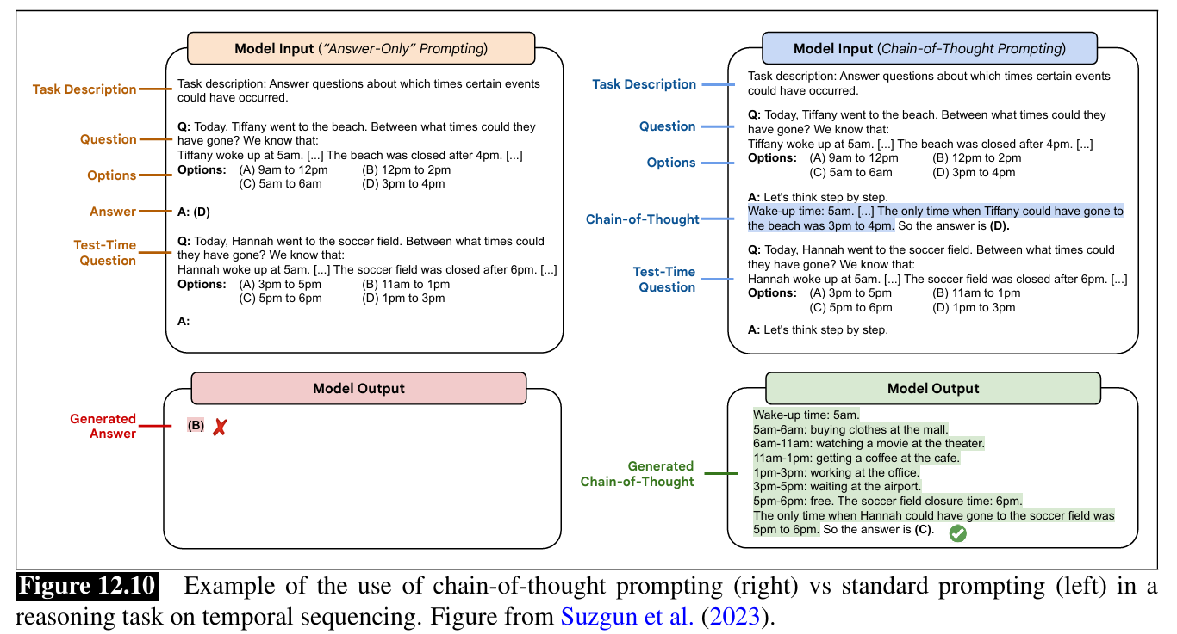

Slide 42
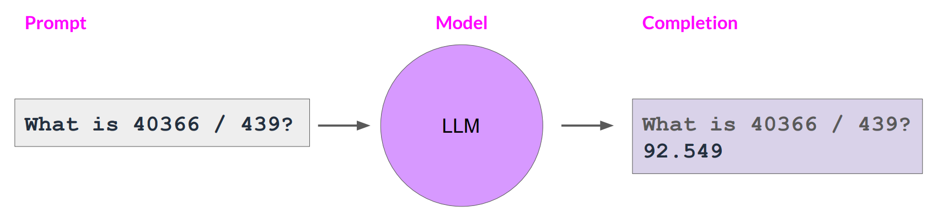
LLMs can struggle with mathematics

Slide 43
Give the model time to think
Tactic1: specify steps to compete a task
step 1: ...
step 2: ...
step 3: ...
...
step N: ....
Tactic 2: instruct the model to work out its own solution before rushing to a conclusion

Slide 44
Example
Determine if the student's solution is correct or not.
Question:
I'm building a solar power installation and I need \
help working out the financials.
- Land costs $100 / square foot
- I can buy solar panels for $250 / square foot
- I negotiated a contract for maintenance that will cost \
me a flat $100k per year, and an additional $10 / square \
foot
What is the total cost for the first year of operations
as a function of the number of square feet.
Student's Solution:
Let x be the size of the installation in square feet.
Costs:
1. Land cost: 100x
2. Solar panel cost: 250x
3. Maintenance cost: 100,000 + 100x
Total cost: 100x + 250x + 100,000 + 100x = 450x + 100,000

Slide 45
refined prompt
Your task is to determine if the student's solution is correct or not.
To solve the problem do the following:
- First, work out your own solution to the problem including the final total.
- Then compare your solution to the student's solution and evaluate if the student's solution is correct or not.
Don't decide if the student's solution is correct until
you have done the problem yourself.
Use the following format:
Question:
```
question here
```
Student's solution:
```
student's solution here
```
Actual solution:
```
steps to work out the solution and your solution here
```
......

Slide 46
More Examples
.....

Slide 47
Automatic prompt
Automatic prompt aims to automatically generate and select the appropriate instruction for the LLMs, instead of requiring the user to manually engineer a prompt.
Automatic prompt engineering leverages AI to:
Generate Prompts: Create initial prompts based on a set of criteria or examples.
Optimize Prompts: Modify existing prompts to improve the quality of the AI's responses.
Refine Prompts: Iteratively adjust prompts based on feedback or desired outcomes.
Example: Ideogram

Slide 48
Generate Knowledge Prompt
A "Generate Knowledge Prompt" is a type of prompt designed to elicit comprehensive and detailed information from an AI model on a specific topic.
This type of prompt aims to generate in-depth content that contributes to understanding, learning, or expanding knowledge on a subject.

Slide 49
Purpose for Knowledge Prompt
Education: To provide detailed explanations, descriptions, or discussions on academic or educational topics.
Research: To gather comprehensive insights and information for research purposes.
Content Creation: To generate informative content for articles, blogs, or educational materials.

Slide 50
Examples of Generate Knowledge Prompts
Explain a Concept: "Explain the theory of relativity in detail, including its historical background, key principles, and implications."
Describe a Process: "Describe the process of photosynthesis, detailing each step and its significance in the overall mechanism."
Historical Analysis: "Analyze the causes and effects of the Industrial Revolution, highlighting the key changes it brought to society and the economy."
Comparative Analysis: "Compare and contrast the philosophies of existentialism and nihilism, discussing their origins, main proponents, and impact on modern thought."
Technical Explanation: "Provide a detailed explanation of blockchain technology, including its structure, functionality, and potential applications."

Slide 51
Structure of a Generate Knowledge Prompt
Introduction:
Start with a brief introduction or context to set the stage for the detailed response.
Example: "In the field of renewable energy, one of the most discussed technologies is solar power."
Main Body:
Ask for a detailed explanation or description, specifying any particular aspects to be covered.
Example: "Explain how solar panels convert sunlight into electricity, including the scientific principles involved and the components of a solar panel system."
Conclusion:
Optionally, request a summary or conclusion to encapsulate the main points.
Example: "Summarize the benefits and challenges of using solar power as a renewable energy source."

Slide 52
"Tree-of-Thoughts" prompt
The "Tree-of-Thoughts" prompt is a technique used to generate and explore multiple ideas, solutions, or perspectives on a given topic by branching out like a tree.
This method encourages creative thinking and thorough analysis by breaking down complex issues into smaller, manageable parts and exploring various paths or options.

Slide 53
Key Characteristics of "Tree-of-Thoughts" prompt
Hierarchical Structure: The prompt is organized in a hierarchical format, similar to a tree with branches, sub-branches, and leaves.
Exploratory: Encourages exploration of different ideas and solutions.
Analytical: Promotes detailed analysis of each branch to uncover insights and connections.

Slide 54
Purpose of "Tree-of-Thoughts" prompt
Problem-Solving: To explore multiple solutions to a problem.
Creative Thinking: To generate diverse ideas and perspectives.
Decision-Making: To analyze different options and make informed decisions.

Slide 55
Example Structure
Root: The main topic or question.
Branches: Primary ideas or solutions.
Sub-Branches: Detailed aspects or components of each primary idea.
Leaves: Specific points, examples, or implications

Slide 56
Example of a Tree-of-Thoughts Prompt
Prompt: "Explore the different strategies for reducing carbon emissions in urban areas."
This detailed response demonstrates how the Tree-of-Thoughts prompt can be used to explore a topic comprehensively by branching out into various strategies, examining each one in depth, and considering their implications and challenges.

Slide 57
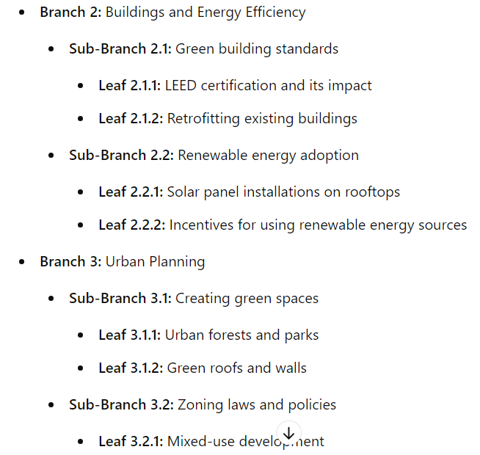
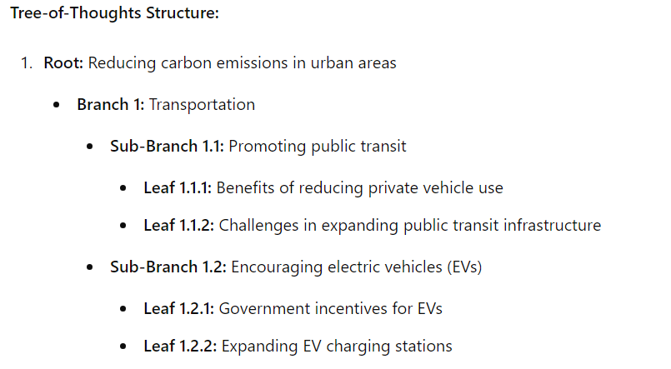

Slide 58
Active Prompt
An "Active Prompt" is a technique in prompt engineering designed to actively engage the AI in a more dynamic and iterative process.
This approach encourages the AI to not only provide information but also to ask questions, seek clarification, and refine its responses based on additional input or context.
The goal is to create a more interactive and collaborative dialogue between the AI and the user, leading to more accurate, relevant, and insightful responses.

Slide 59
Active Prompt
Key Characteristics
Interactive: The AI actively engages with the user by asking clarifying questions or seeking more details.
Iterative: The response is refined through a series of interactions, improving accuracy and relevance.
Dynamic: The prompt evolves based on the ongoing dialogue, adapting to new information or context.

Slide 60
Example Structure of Active Prompt
Initial Prompt: The user provides an initial query or request.
AI Clarification: The AI asks clarifying questions or requests more information.
User Response: The user provides additional details or context.
Update context: The AI refines its response based on the new information.
Iterative Process: Steps 2-4 are repeated as needed to achieve a high-quality response.

Slide 61
Example of an Active Prompt Interaction
Initial Prompt:
"Tell me about the impact of climate change on agriculture."
AI Clarification:
"Can you specify which aspect of agriculture you are interested in? For example, crop yields, soil health, or livestock?"
User Response:
"I'm particularly interested in how climate change affects crop yields."
Refined Prompt:
"Explain how climate change impacts crop yields, considering factors like temperature changes, precipitation patterns, and extreme weather events."
....

Slide 62
Active Prompt: Another example
I do not speak Italian. Help me to fill this form in Italian. Please ask me questions in English about the information that need to be filled, and I will respond to your questions, after you complete questioning for all the required information, fill the form for me.
___ Il/La sottoscritto/a _ _____________________________________ nato/a a ________________________________________ (prov. di ____ ) il ___________ e residente in _______________________________ (prov. di _____) c.a.p. ________ via __________________________________________ n. _____ PEC _____________________________, email ________________

Slide 63
Active Prompt: AI response
Sure, I'll help you fill out this form in Italian. I'll ask you a few questions to gather all the necessary information. Please provide the answers, and then I'll fill out the form for you.
What is your full name?
What is your place of birth (city and province)?
What is your date of birth?
What is your current residence (city and province)?
What is your postal code (c.a.p.)?
What is your street address and house number?
What is your PEC (Certified Email Address) if you have one? If not, you can provide your regular email address.

Slide 64
Directional Stimulus Prompt
A "Directional Stimulus Prompt" is a type of prompt used to guide an AI model's response in a specific direction or focus.
Unlike broad prompts that allow for wide-ranging responses, directional stimulus prompts provide a clear direction or emphasis on certain aspects of the response, aiming to elicit focused and targeted information.
Purpose
Precision: To guide the AI model towards providing detailed and specific information.
Clarity: To ensure the response is aligned with the user's intent or query.
Efficiency: To streamline the generation of relevant content or information.

Slide 65
Example of a Directional Stimulus Prompt
Broad Prompt:
"Explain the concept of artificial intelligence."
Directional Stimulus Prompt:
"Explain the concept of artificial intelligence, focusing on its applications in healthcare."
AI Response:
"Artificial intelligence (AI) refers to the simulation of human intelligence in machines that are programmed to perform tasks that typically require human intelligence, such as learning, reasoning, problem-solving, and decision-making. In healthcare, AI is revolutionizing the industry by enabling advanced diagnostics, personalized treatment plans, and predictive analytics.

Slide 66
More resources
https://platform.openai.com/docs/examples
https://github.com/ncwilson78/System-Prompt-Library
https://github.com/motazsaad/Generative-AI

Slide 67


Q&A

